Slide 1
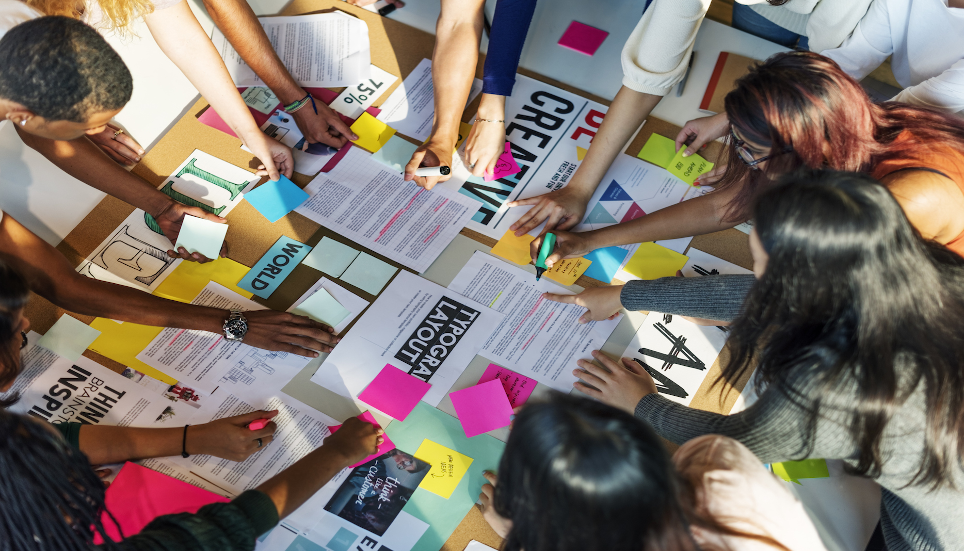
The Project

Slide 2
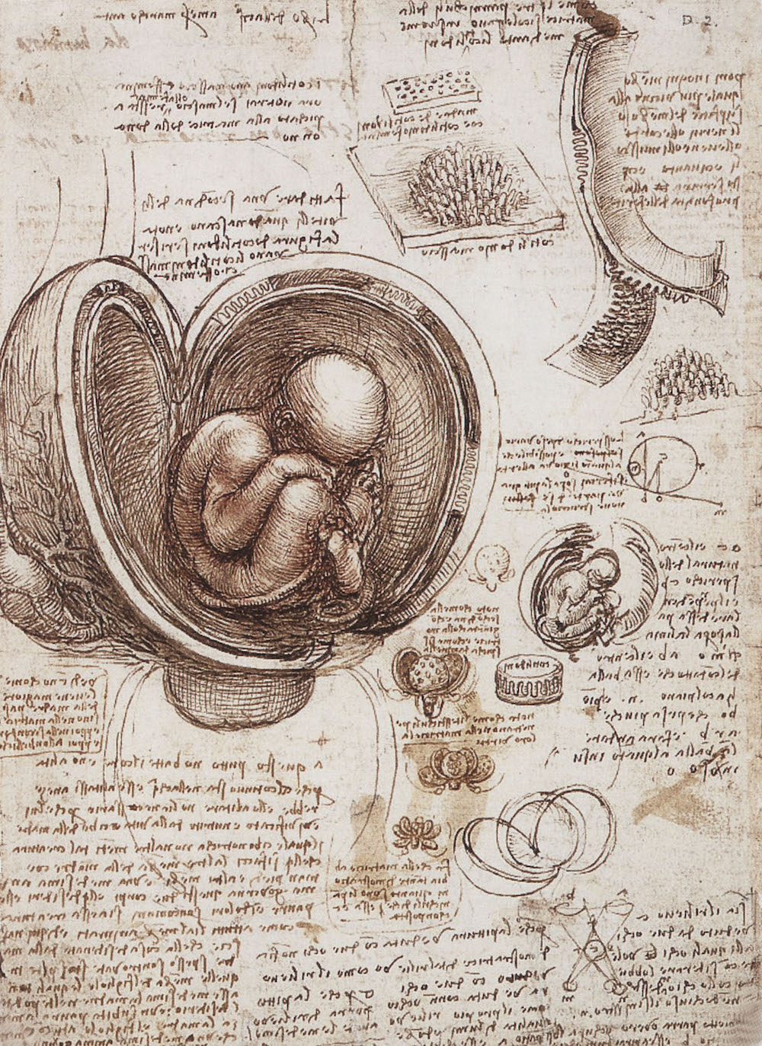
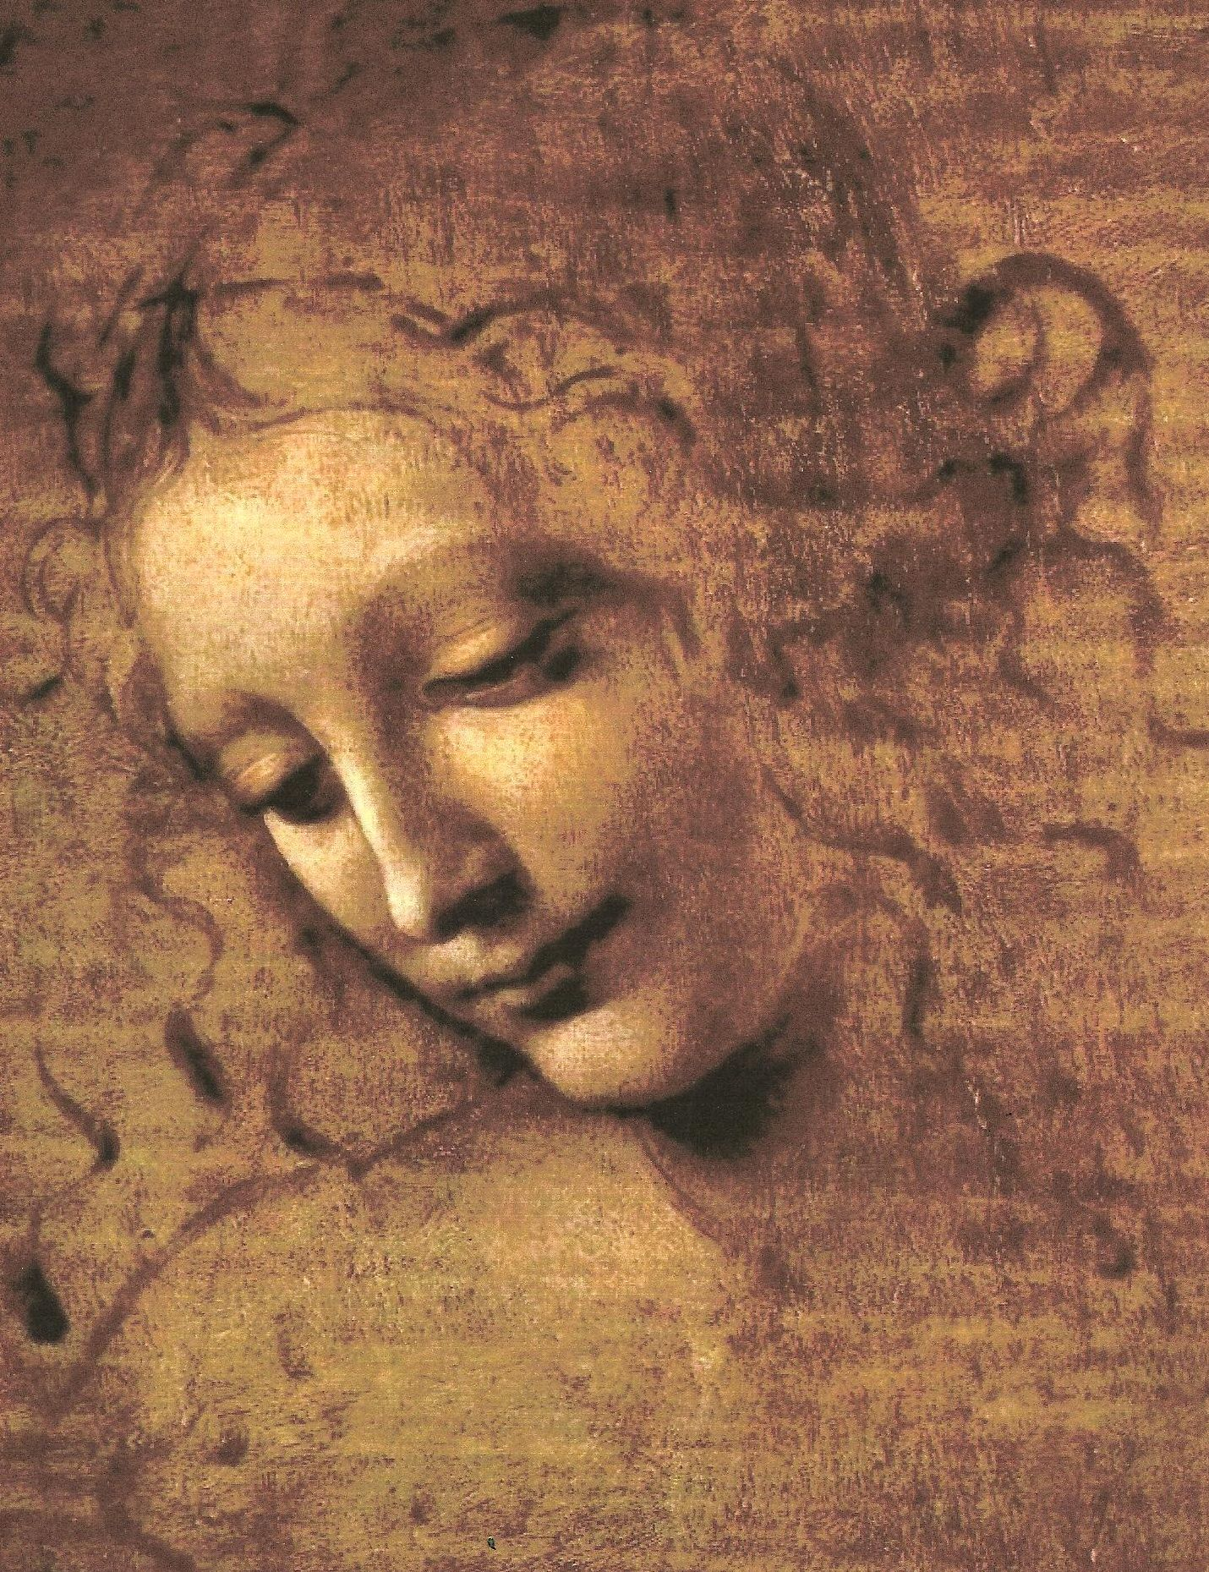
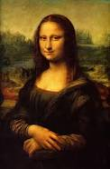
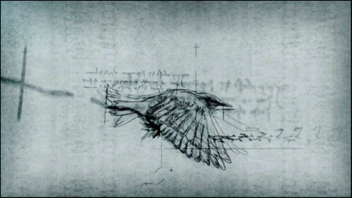
To develop a complete mind: Study the science of art; Study the art of science. Learn how to see. Realize that everything connects to everything else
Leonardo Da Vinci

Slide 3
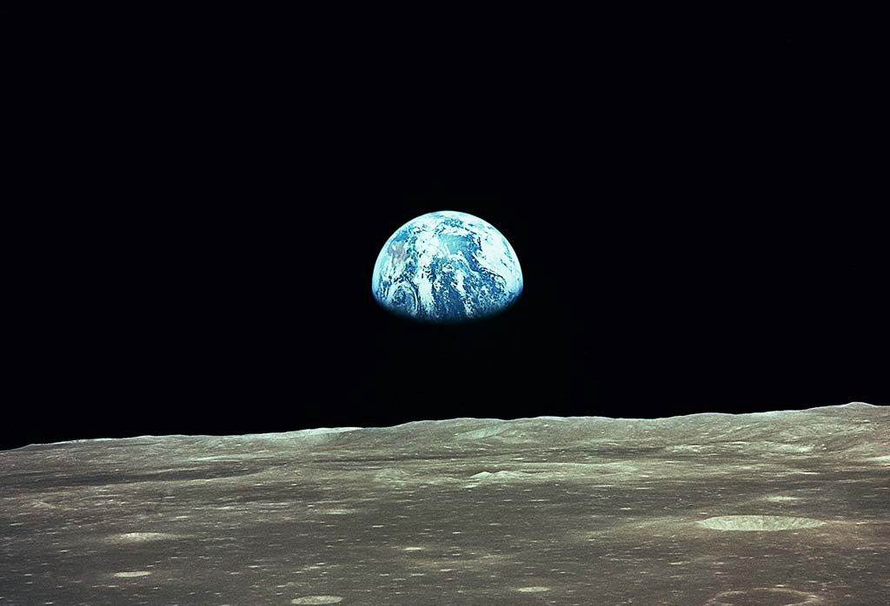
Sustainability:
We are all connected in time, space and life.

Slide 4
The Hub

Slide 5
Advertising/Crowd Funding
Companies etc
Events
Products/Services
(Sustainable)
1
2
8
Weekly/Monthly Events
Local news
National
International
Sustainability Education
Materials (Categorised)
Videos/Interviews
Links
Games
3
Sustainable/Social Global Action
Link to Global partners with local sustainability/social issues
Monthly updates
Videos/Interviews
Registration for new members
6
Sustainability App store
Download/Upload
App Description
User registration
Sustainability
Hub Website
5
4
7
Sustainable @ Universities & Colleges
Student Projects on campus
Research (UCD + others)
Seminars/Lectures
Events
Sustainable Action Success
Successful sustainable/Social projects around the world.
Aspects/metrics of success
Videos/Interviews
Articles
One Million Tree Project
Project background
Registration & Members
Target update
Social impact
Environmental/Ecological
impact

Slide 6
Sustainability Website Hub
The Hub:
Provides a central website where all sub-projects can be publicised.
Collectively integrates all projects under a common theme : Sustainability.
All projects become contributors to One project. The Hub amplifies the effort of the individual projects.
Construction and management of The Hub is a project it-self.
Serves a communication channel for all projects to publicise their activities.

Slide 7
Consists of the following sub-sections of the Hub website:
Weekly/Monthly Events.
Sustainability Education Materials.
Sustainability/Social Global Action.
Sustainable Action Successes.
Sustainability @Universities & Colleges.
Sustainability App store.
One Million Tree campaign
Crowd-funding and advertising.
Each sub-section is a student team project that designs, implements and manages the content(source) of their sub-section pages.
Each sub-section team can learn and support other groups due to the commonality of objectives (style, registration format etc). The main objective of each team is to maintain the aesthetic style and ethos of the Hub, and define and manage the content of the pages.

Slide 8
There will be an editorial and co-ordinating group ( T.A, Demonstrators, Lecturer) that will have the responsibility to direct, manage and deliver a coherent, informative, easily navigable, visually enticing and intuitive Hub.
Each group will appoint a Team Leader. The team conduct their work using an Agile development Principles employing a Scrum methodology with weekly reviews. The team leader will keep the weekly scrum reports for the team. Each team member will keep their individual weekly diary of actions and meetings.
The Hub has two other tasks in addition to the sub-sections identified above.
One Million Tree Project.
Crowd-funding /Advertising.

Slide 9
The One Million Tree project is a global university/college initiative, uniting and encouraging student groups around the world to plant one million trees to mitigate the effects of carbon emissions, and educate communities on the importance and significance of trees in sustainability. Student projects will plant trees or generate funds to do so. The project will also highlight the ecological and social benefits of trees in their communities through videos/interviews and papers that will be published on the Hub.
The One Million Tree project will also generate international attention and publicity, and a wide community for the Hub.
A sub-group will investigate and develop the crowd-funding and advertising potential of The Hub so that a sustainable revenue stream can be secured for its future development. The same group will also be responsible for a Crowd-funding initiative that will inaugurate the launch of the Hub.

Slide 10
Each group will produce their webpages etc and a 20 minute presentation given by three members of the group. Everyone will also submit an individual 3-5 page report, describing their responsibilities, achievements and suggestions for future work.
Enjoy, use your imagination and be creative
Students have a choice to continue their project, or start a new one in the elective module Enviro Tech Bootcamp Comp 30840. This module is all team project based and involves no exam (see details in module descriptor).

